Slide 1



Slide 2
What is Travelstart?
Travelstart is an African online travel booking website, offering flights, hotel bookings, car rental, vacation packages and other travel services through their online booking engine.
The website uses global distribution systems such as Amadeus IT Group and Travelfusion for flights, and CarTrawler for online car hire bookings.

Slide 3
How does it work?
When you search for flights with us, you'll get results from all the major international airlines and low-cost carriers, neatly displayed in one table – lowest prices first of course - so that you can compare costs with ease and find that perfect ticket that works with your schedule and budget. Once you’ve decided on the best flight for you, book and pay online in one seamless transaction – you can do the same to reserve your hotel and rental car too! Taking the hassle out of your travel planning, our team of dedicated agents work around the clock to assist you with any changes, queries or concerns you might have, so you can focus on the fun stuff.

Slide 4
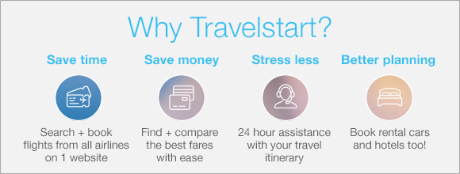
Why use it?

Slide 5
REQUIREMENTS
The system shall provide flight, hotel accommodation and car rental enquiries.
The system shall deal with different airline, hotel and car rental companies.
The system shall verify the user schedule to schedule a travel.
The system shall book the flight, the hotel accommodation and the rental car upon the approval by the user.
The system shall send a memo to the user about the travel information and alert user before the flight. The period before which the system shall remind the user is specified in the user profile.
The system shall automatically enquire for flights depending on the user destination preferences and his/her flight booking history. The period when the system shall initiate an enquiry to get a flight ‘deal’ is specified in the user profile.

Slide 6
Technologies used
Bellow is the list of technologies which will be used through out the project and will also give a brief description of each technology.
Github – used to save the project code
.NET web API – used for back-end development.
MySQL – Database management system
Angular 4 – HTML, JavaScript , CSS, Bootstrap – used for the front-end system.
C#- Platform

Slide 7
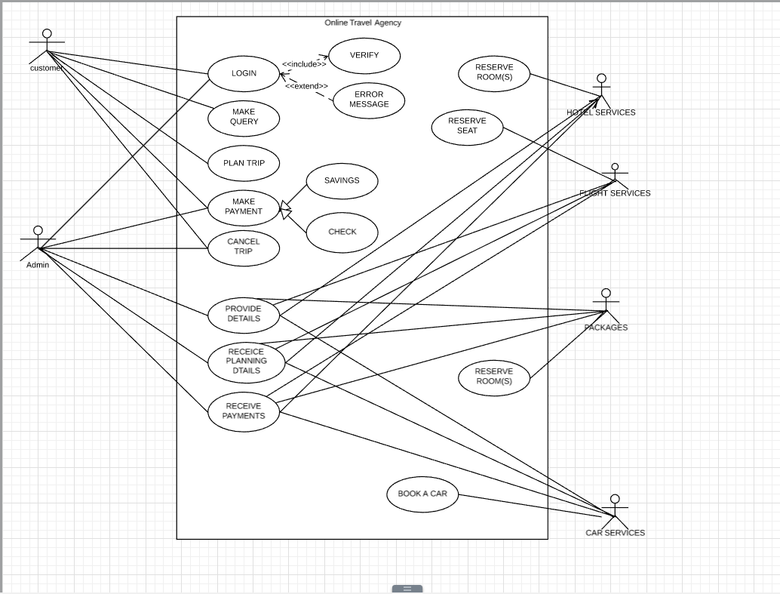
CASE DIAGRAM

Slide 8
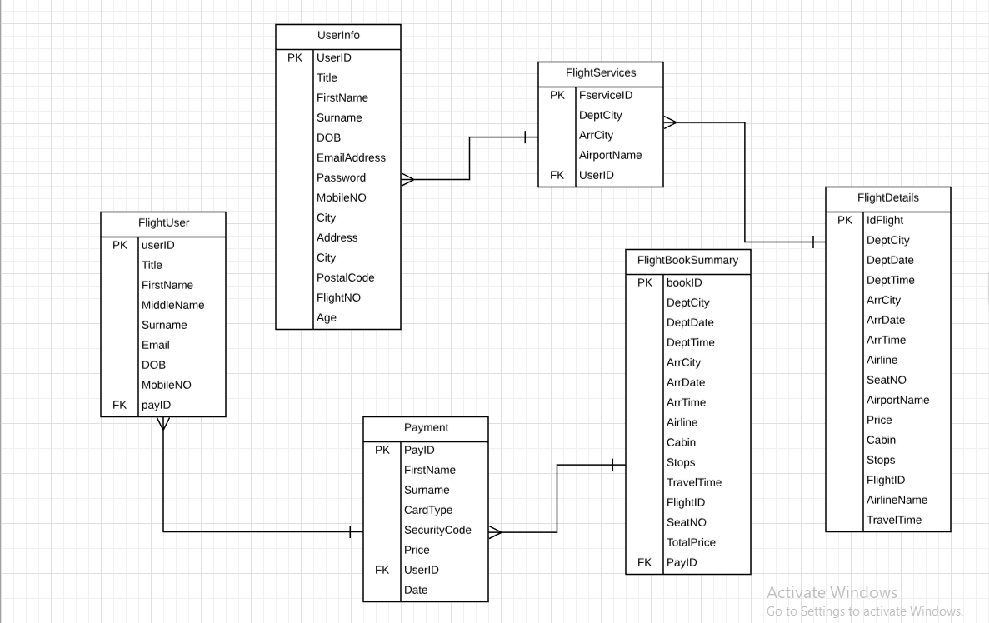
ENTITY RELATIONSHIP DIAGRAM

Slide 9
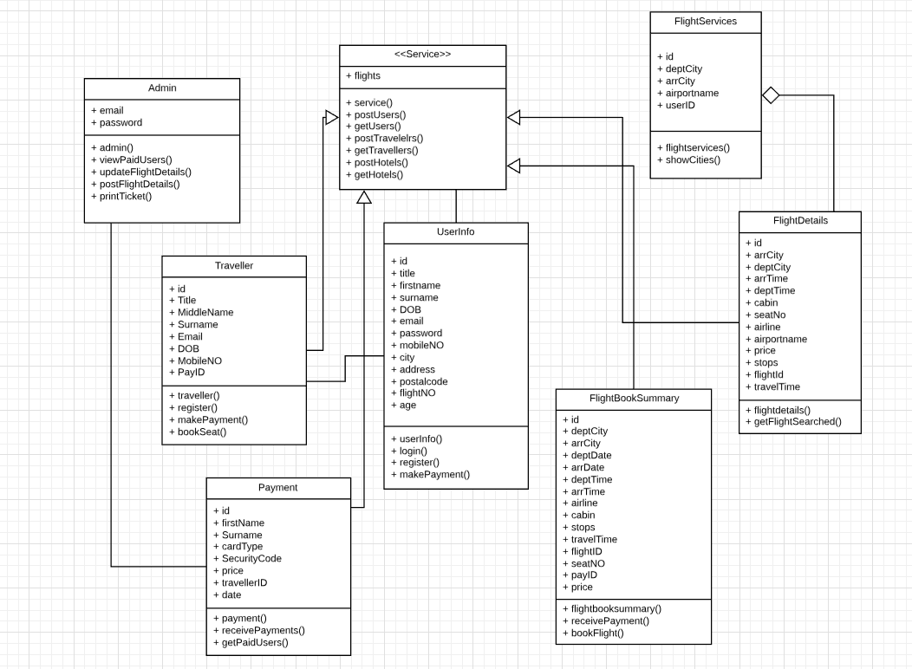
CLASS DIAGRAM

Slide 10
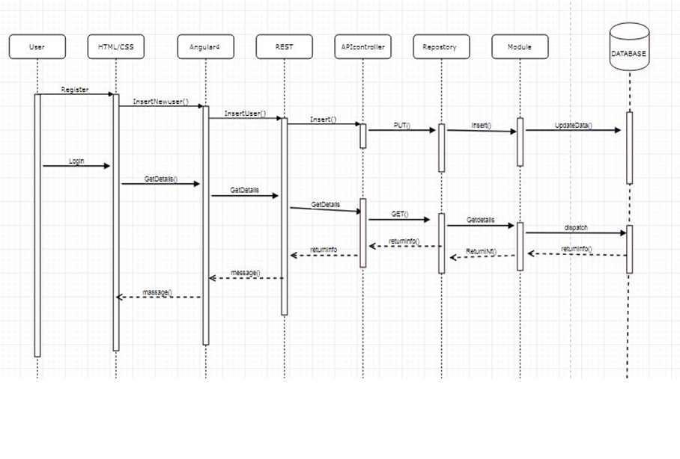
SEQUENCE DIAGRAM

Slide 11
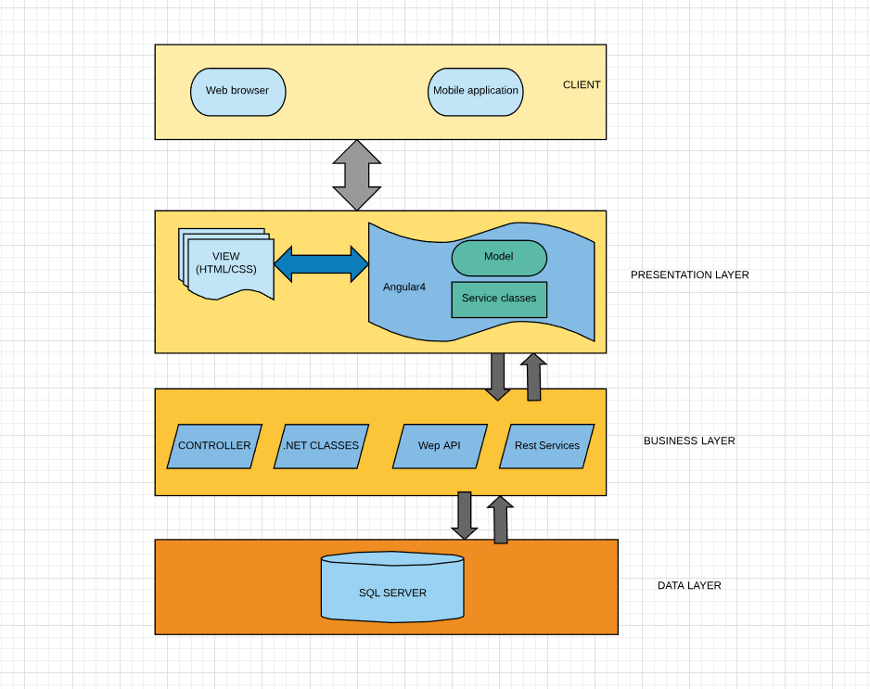
ARCHITECTURE DIAGRAM

Slide 12
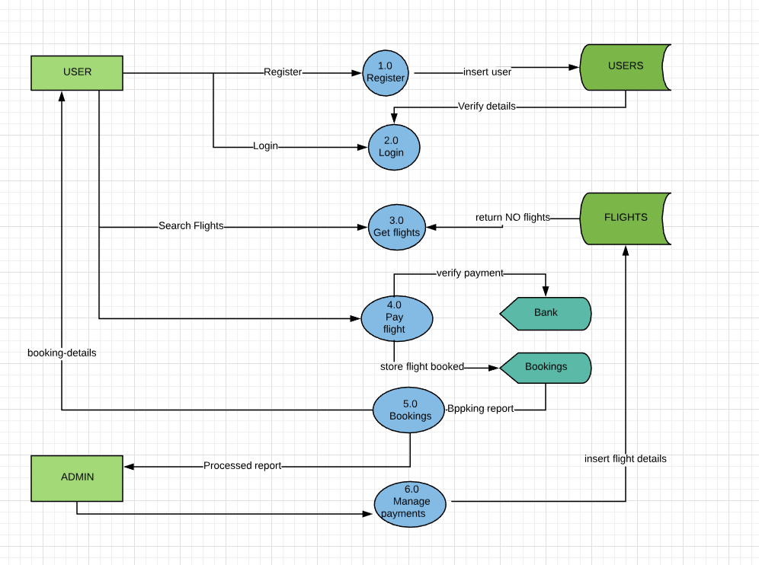
DATA FLOW DIAGRAM

Slide 13
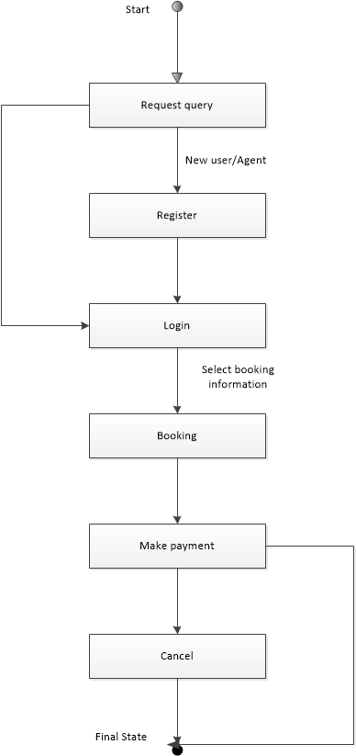
STATE DIAGRAM

Slide 14

Web Application

Slide 15
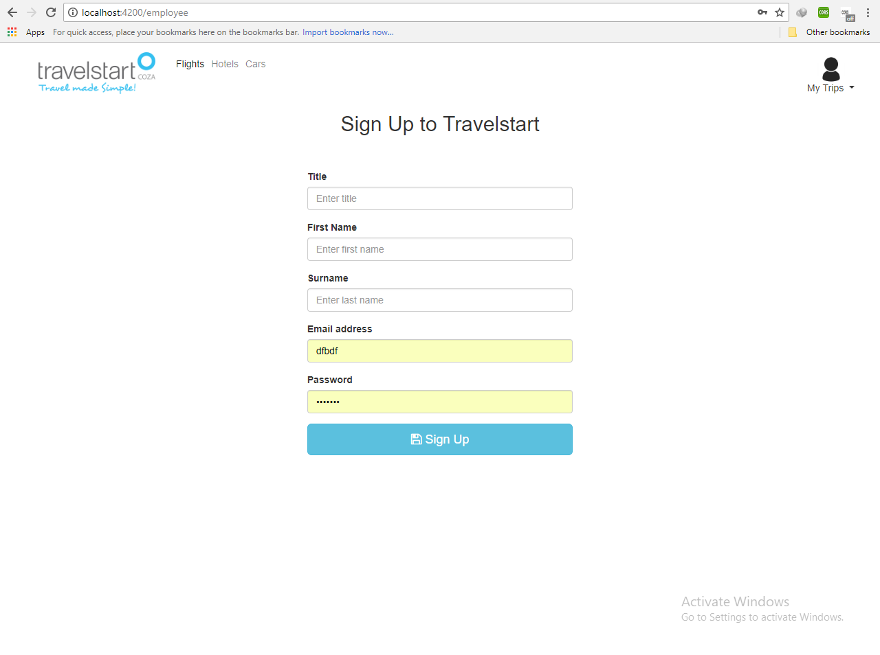
1.SIGN UP UI

Slide 16
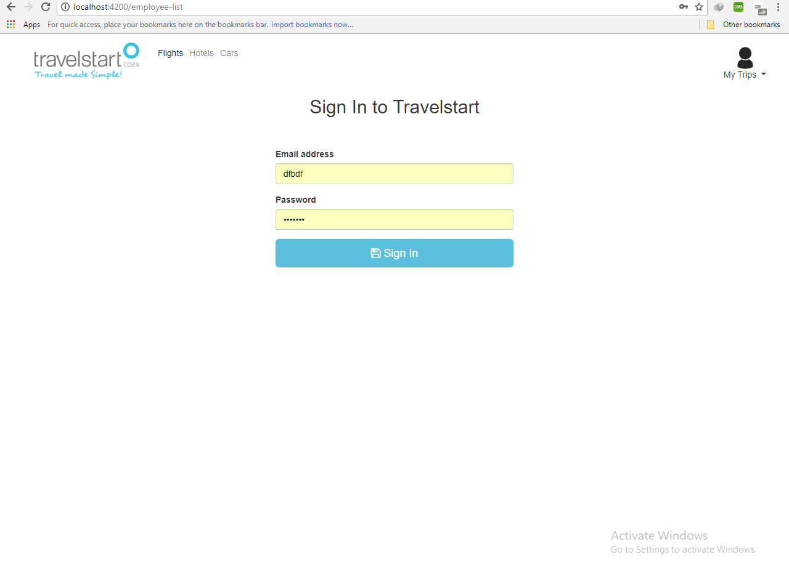
2.SIGN IN

Slide 17
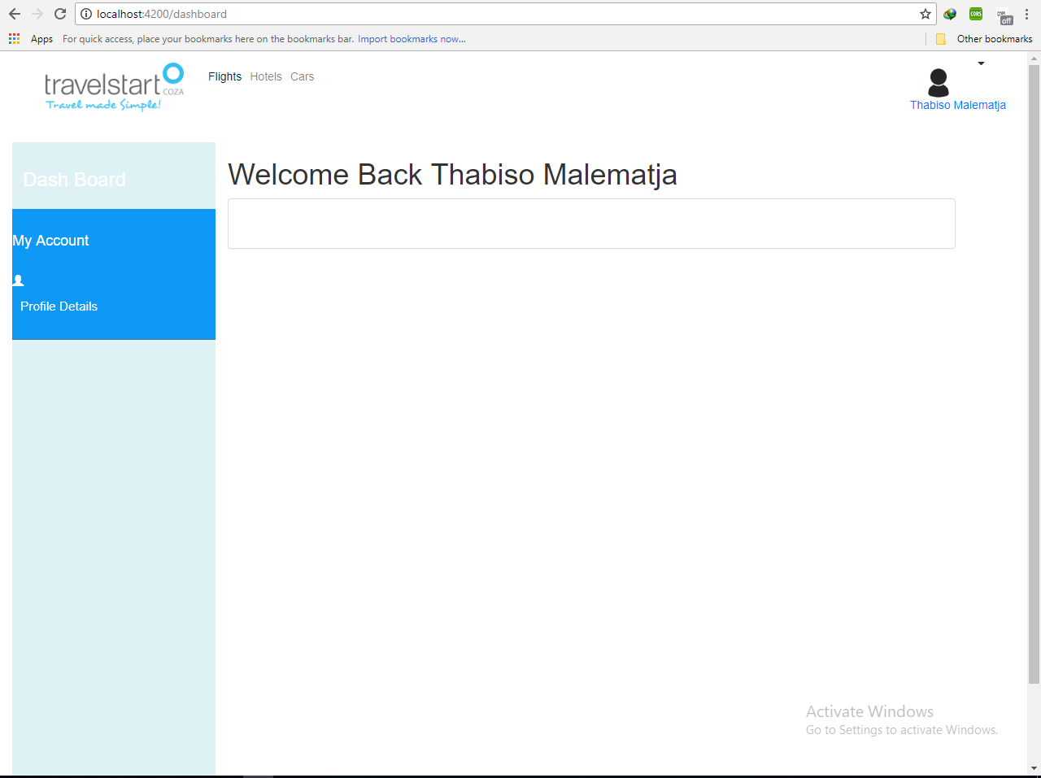
3.Dashboard

Slide 18
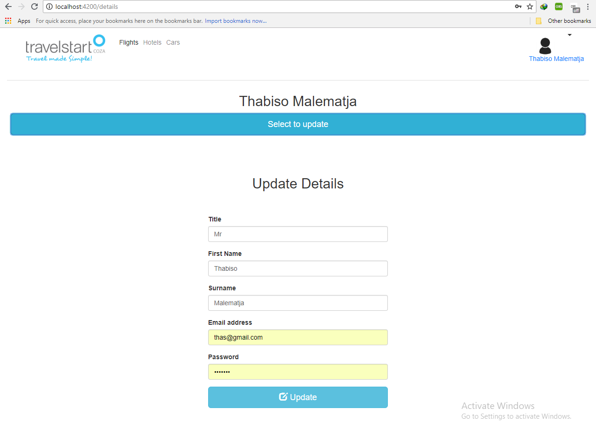
4.Updating Details

Slide 19
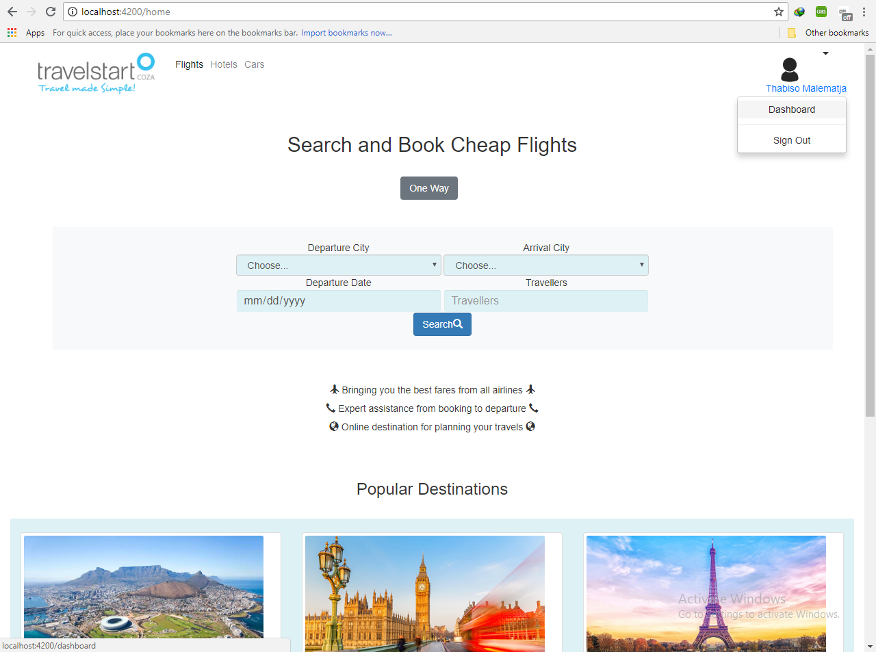
5.HOME PAGE

Slide 20
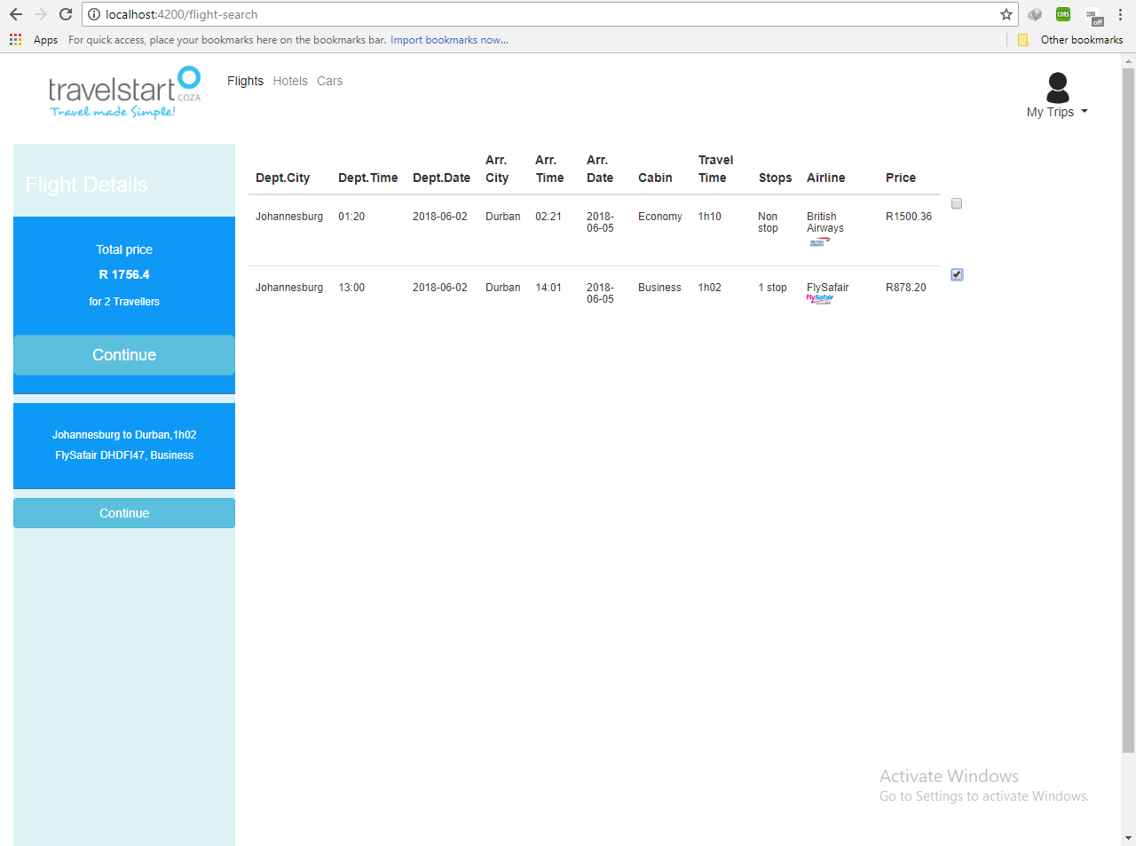
6.FLIGHT SEARCH RESULTS

Slide 21
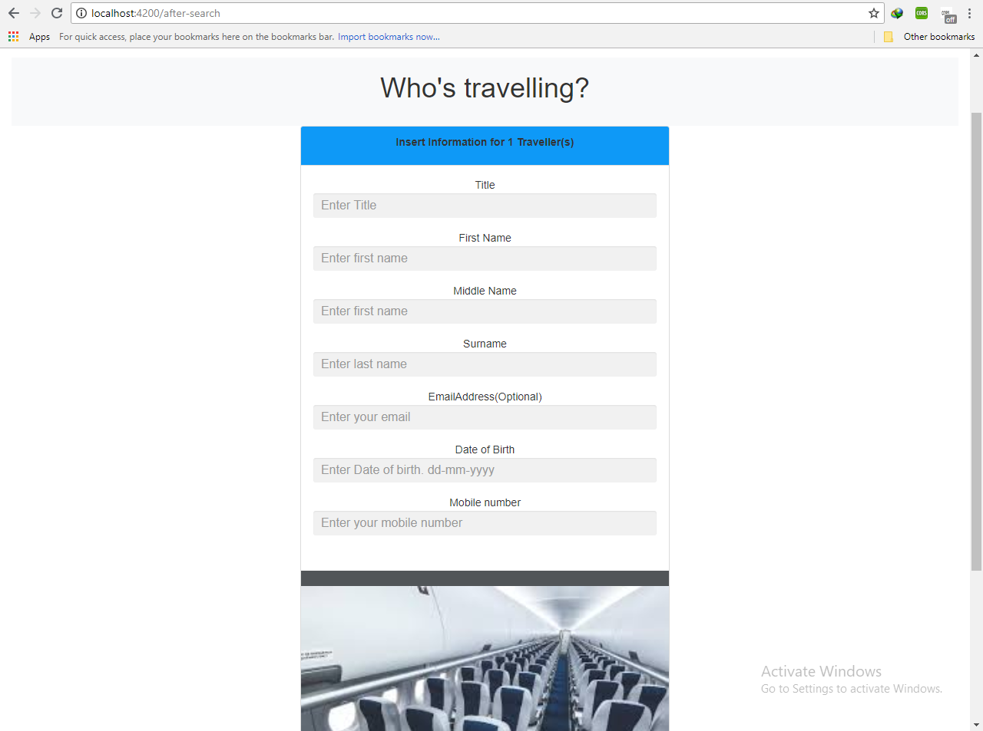
7.TRAVEL DETAILS

Slide 22
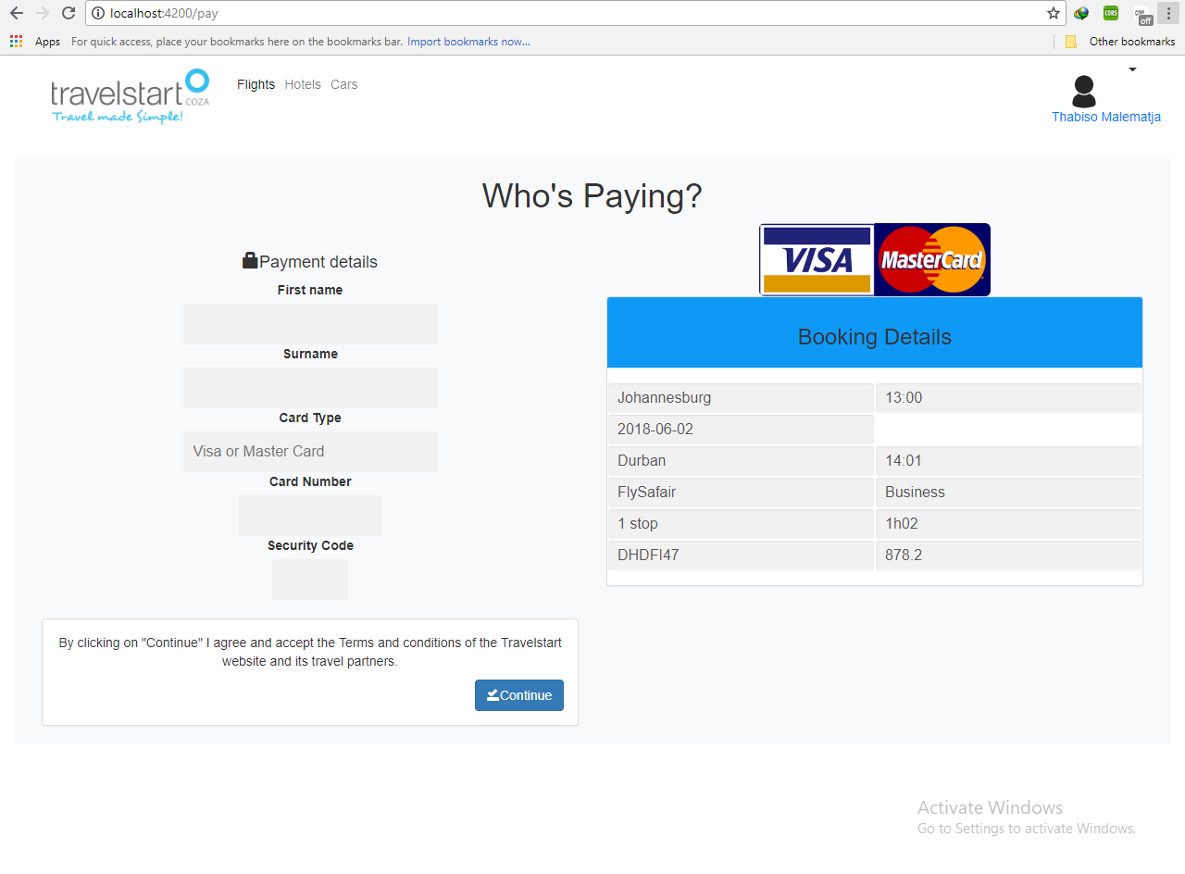
8.Payment

Slide 23
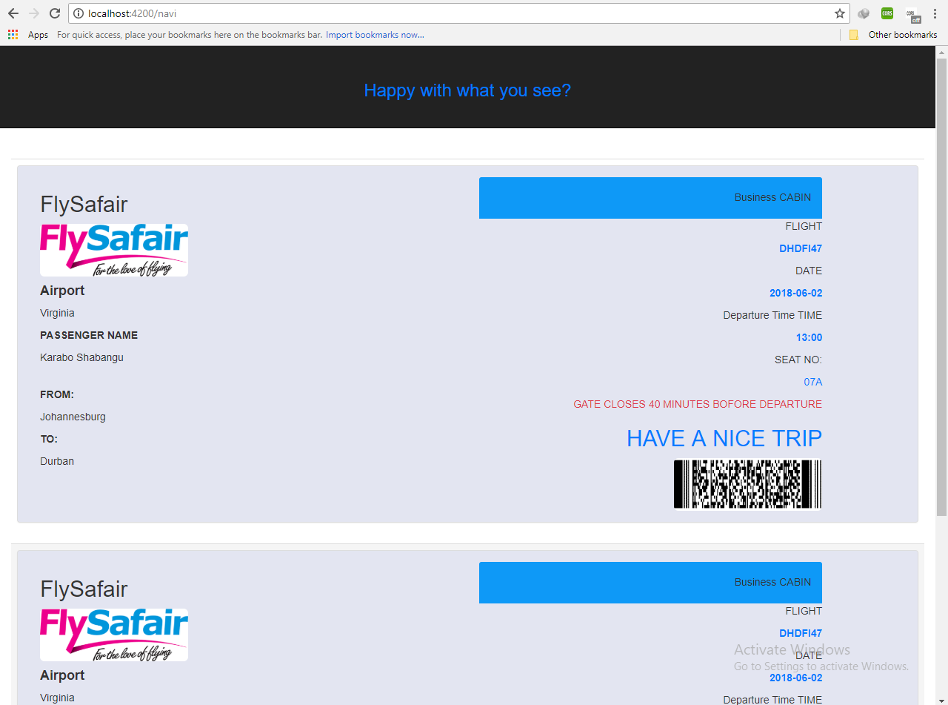
9.TICKETS

Slide 24
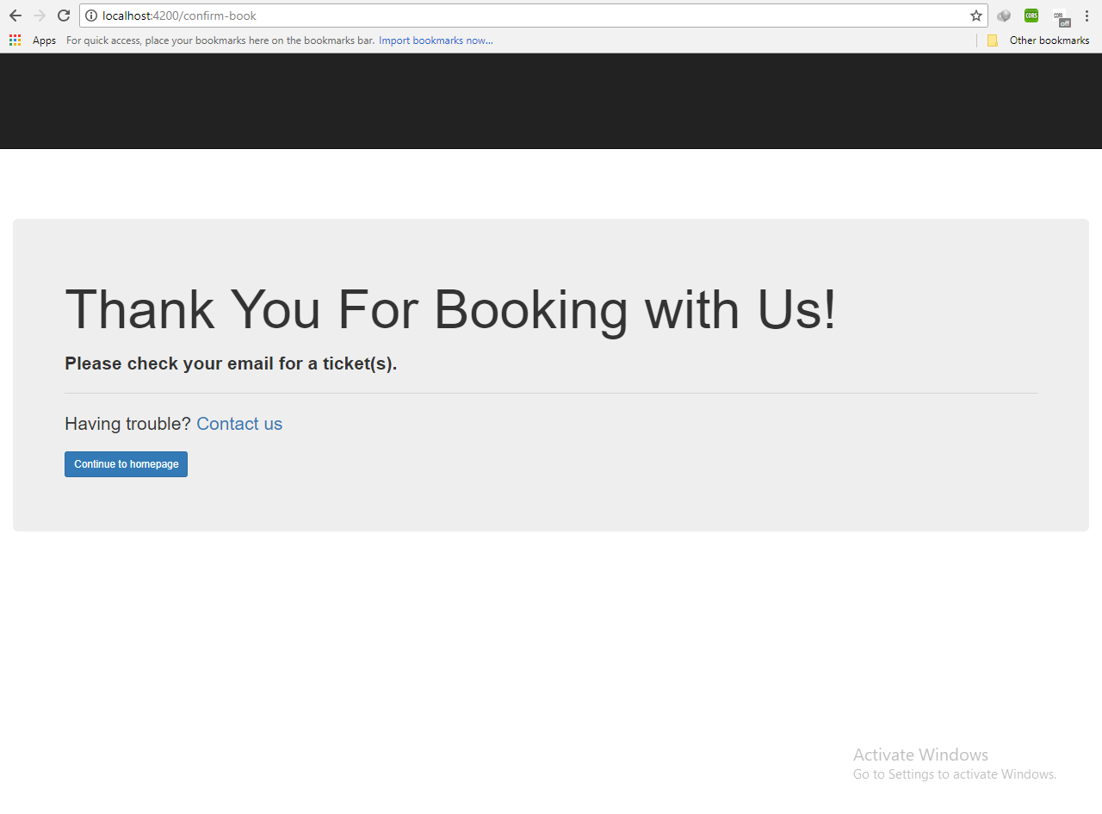
10.FINAL STEP

Slide 25
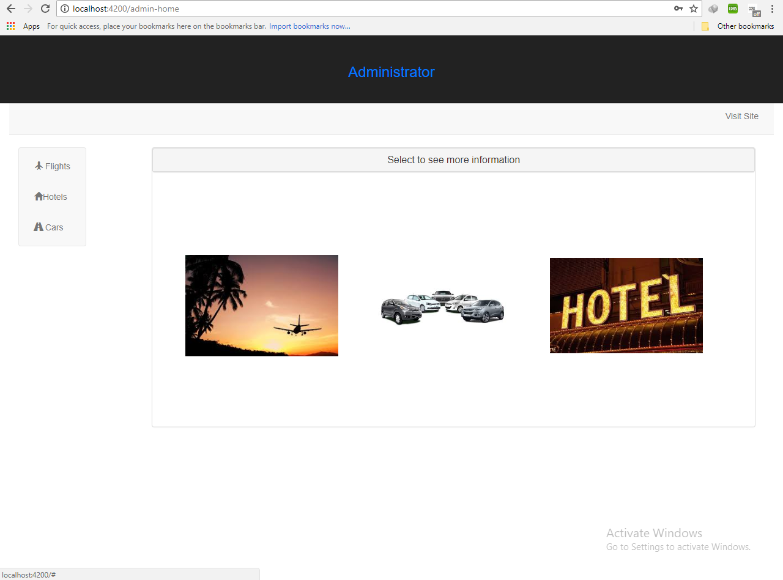
11.ADMIN

Slide 26
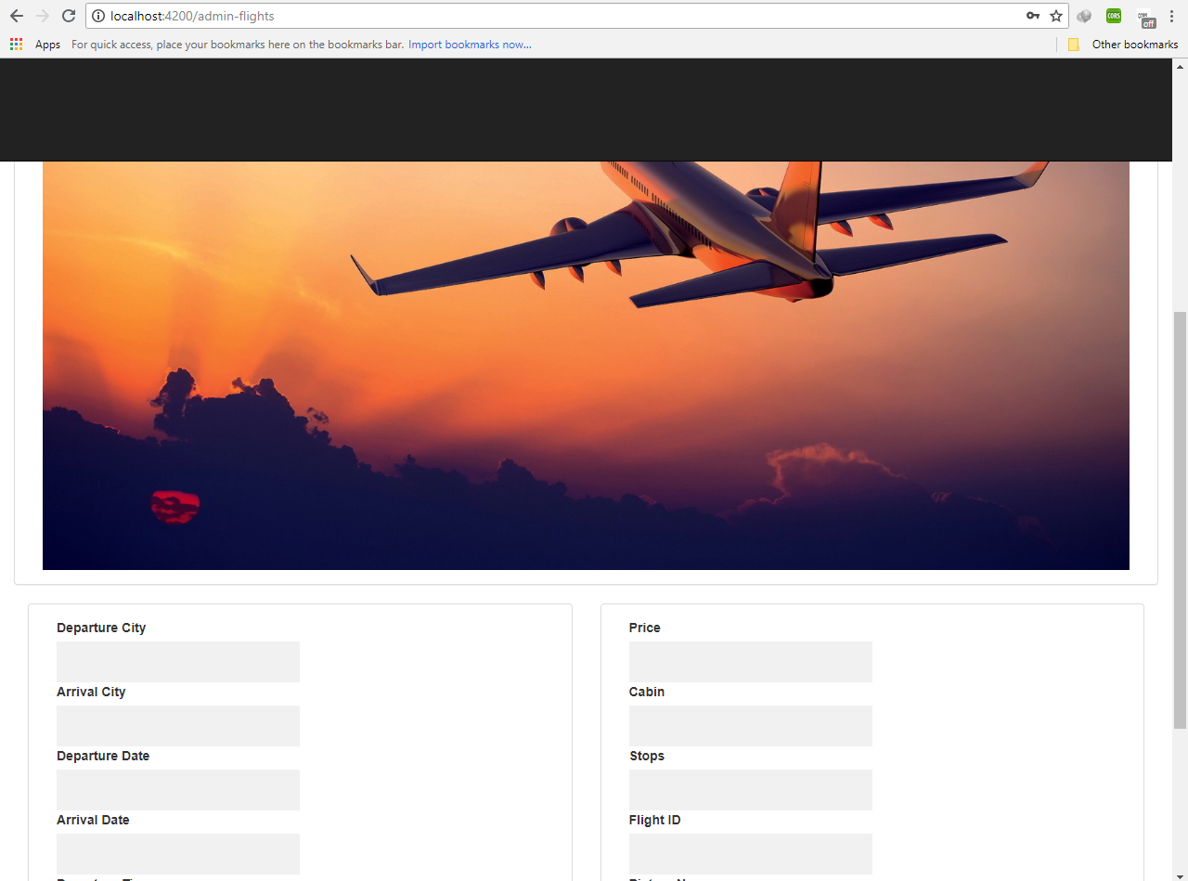
12.ADDING NEW FLIGHTS

Slide 27
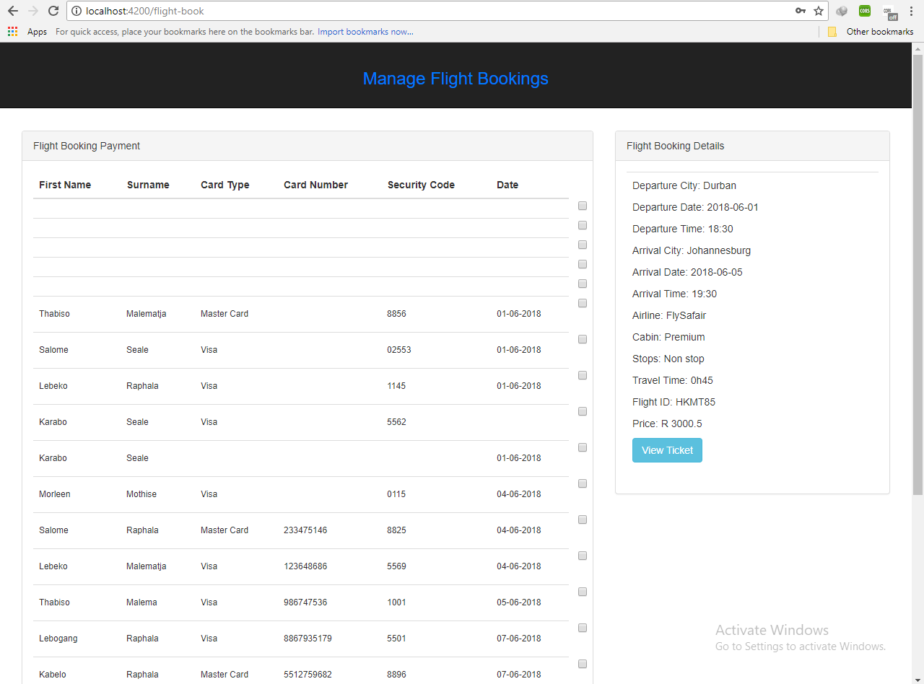
13.VIEW TRAVEL DETAILS

Slide 28
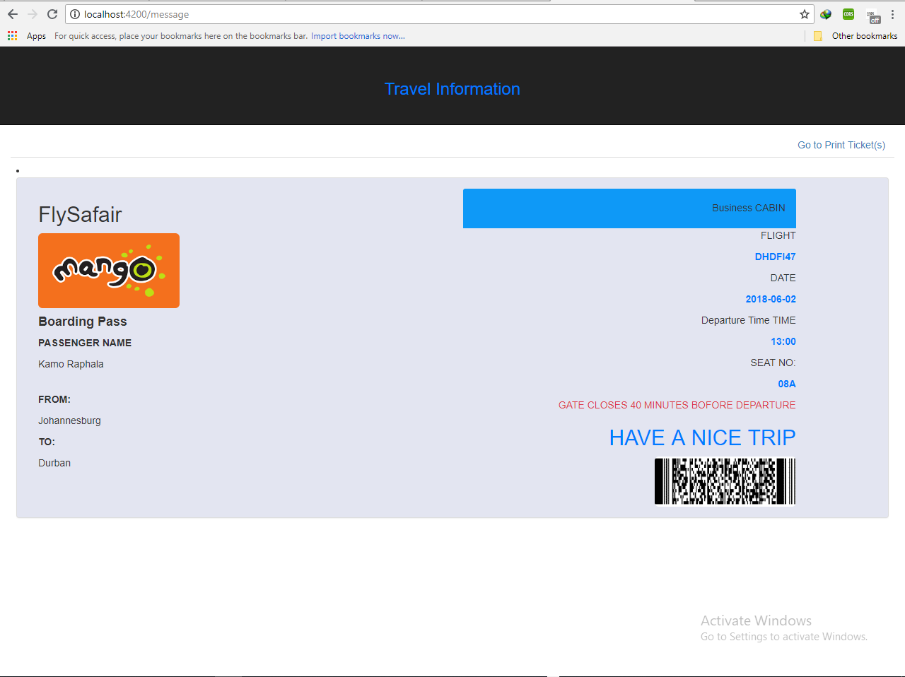
14.View Ticket(s)

Slide 29
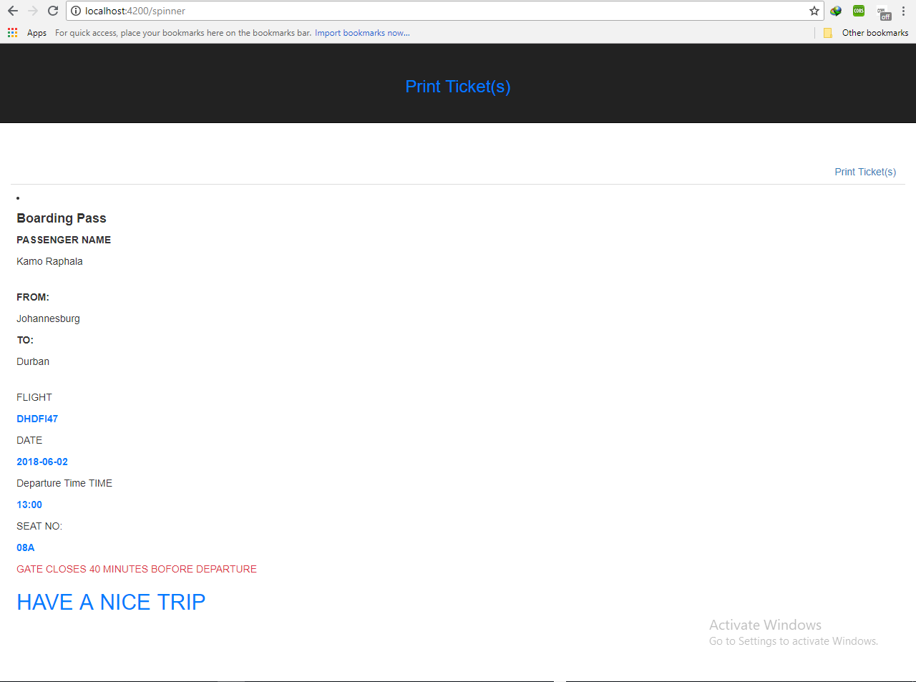
15.Print Ticket(s)

Slide 30

Android Mobile Application

Slide 31
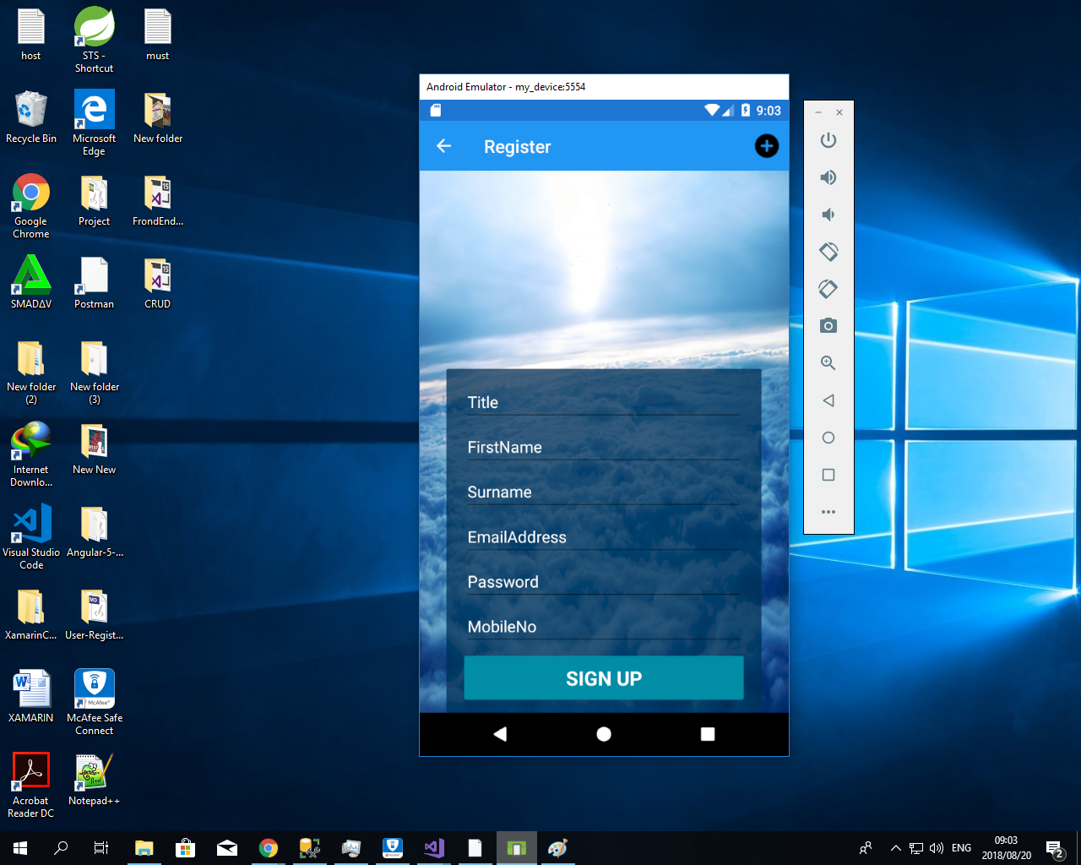
1. Sign Up

Slide 32
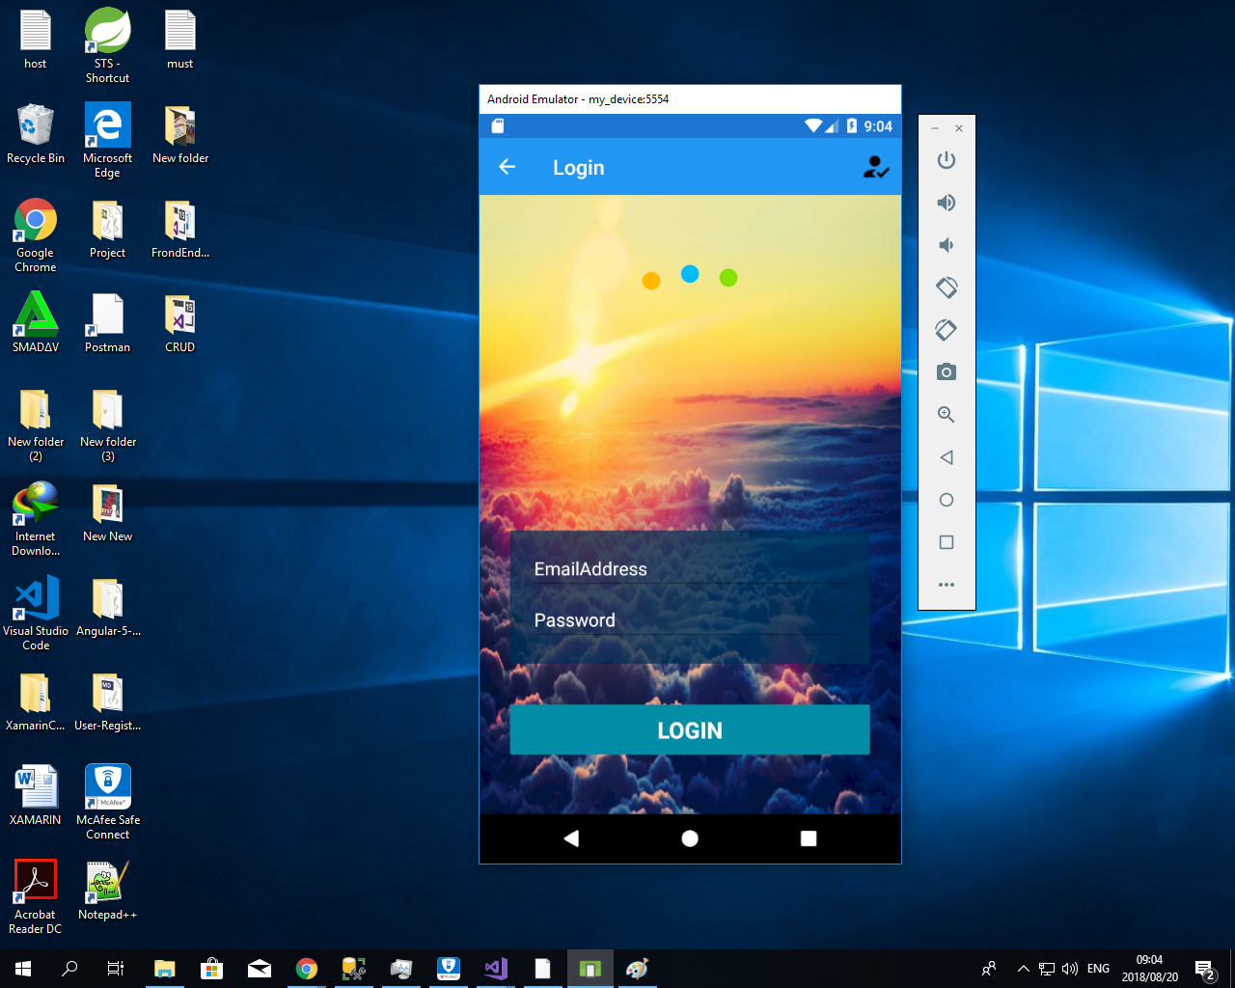
2. Sign In

Slide 33
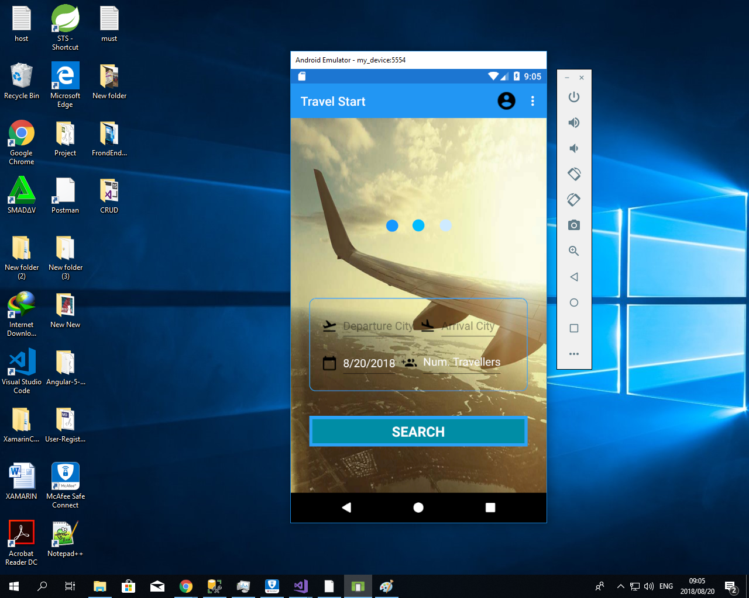
3. Home Page

Slide 34
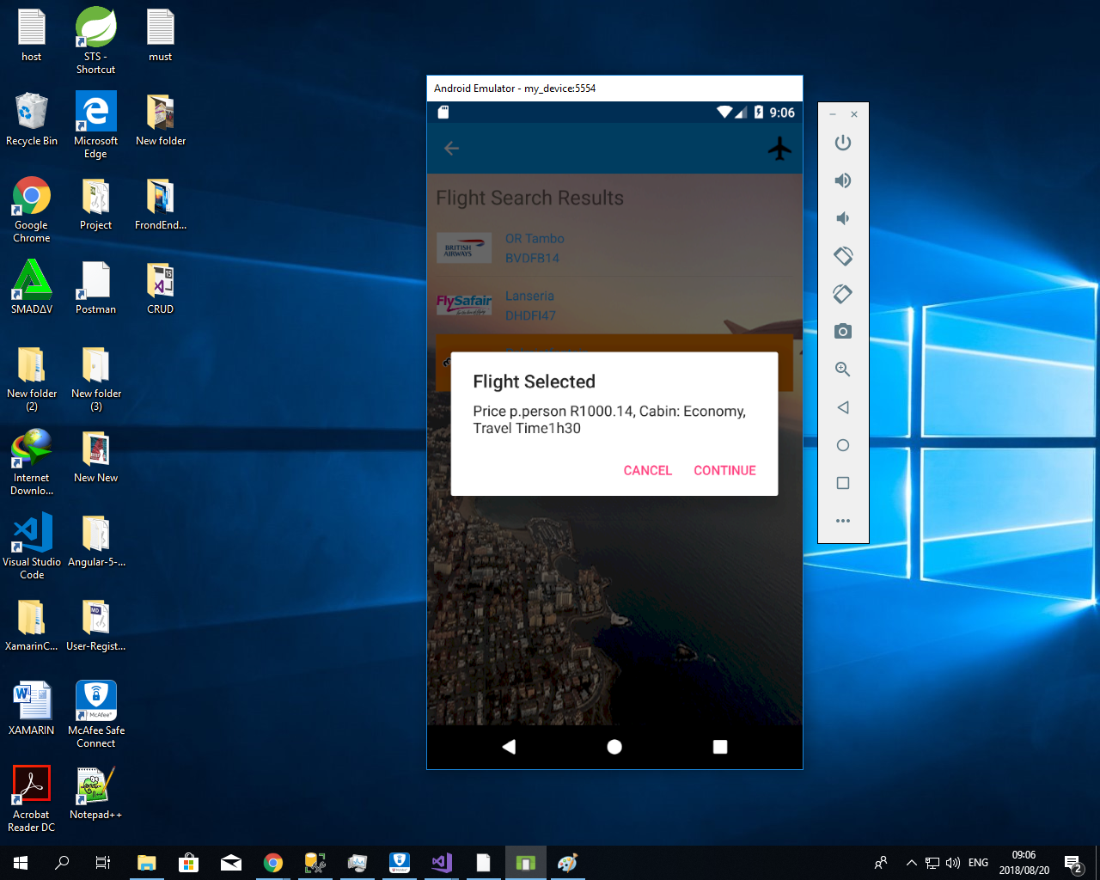
4. Flight Search Results

Slide 35
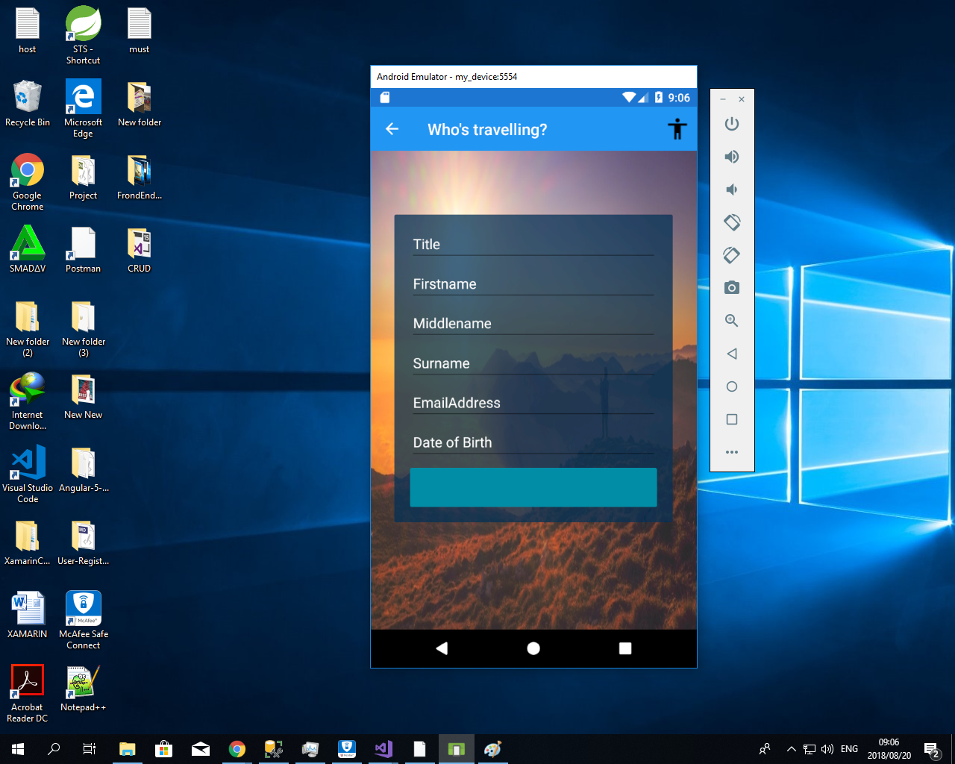
5. Travel Details

Slide 36
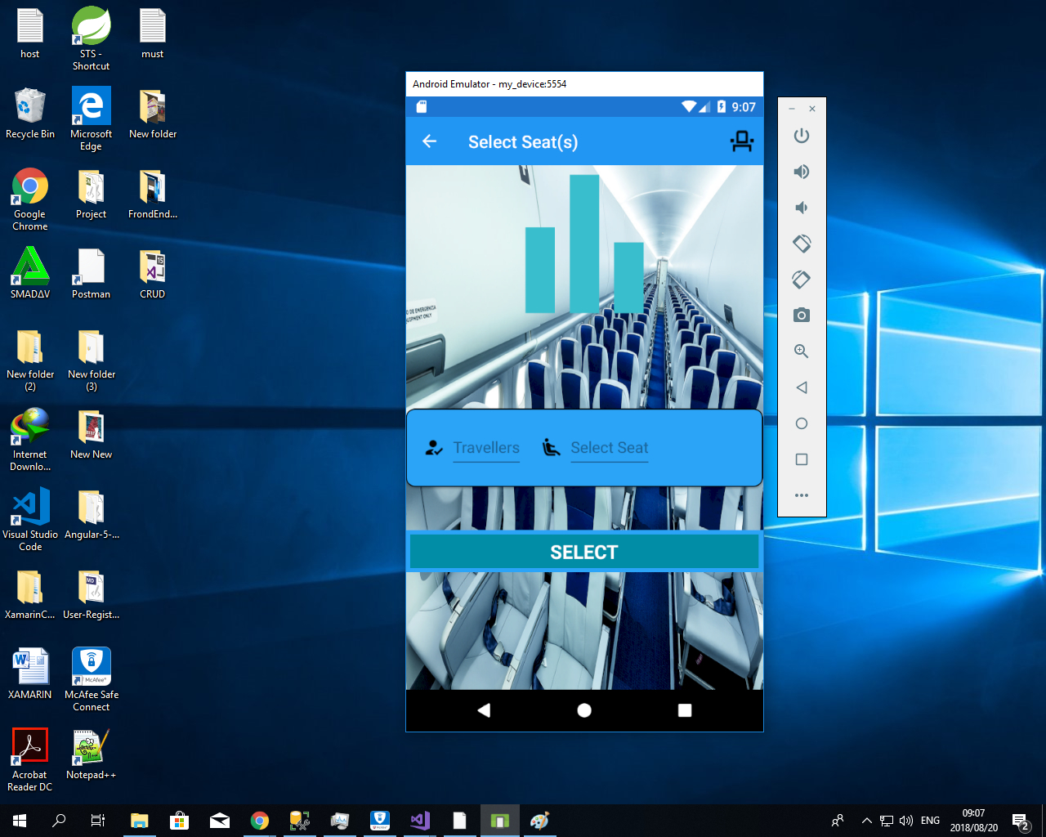
6. Select Seat

Slide 37
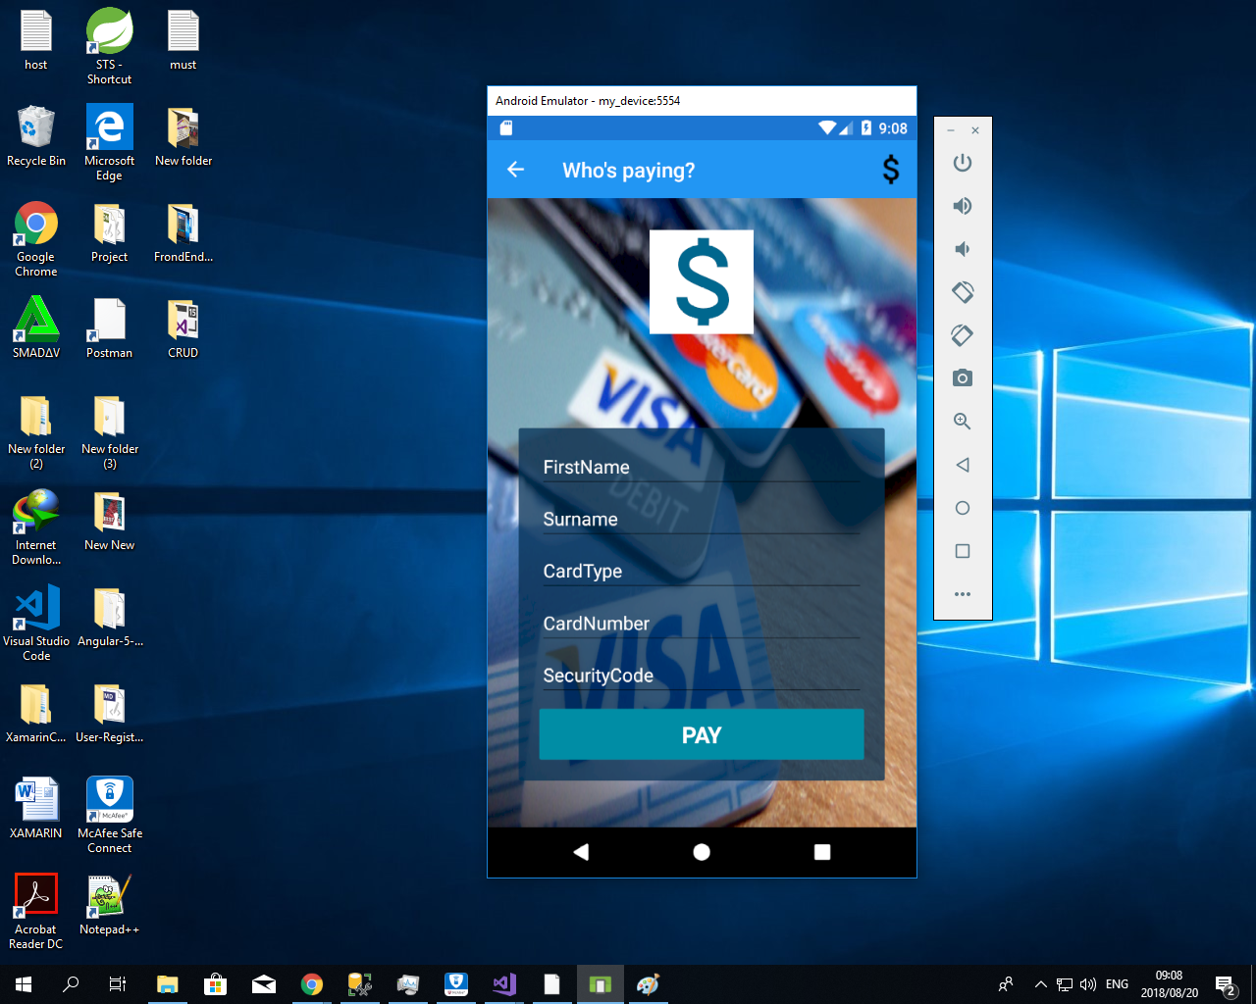
7. Payment

Slide 38
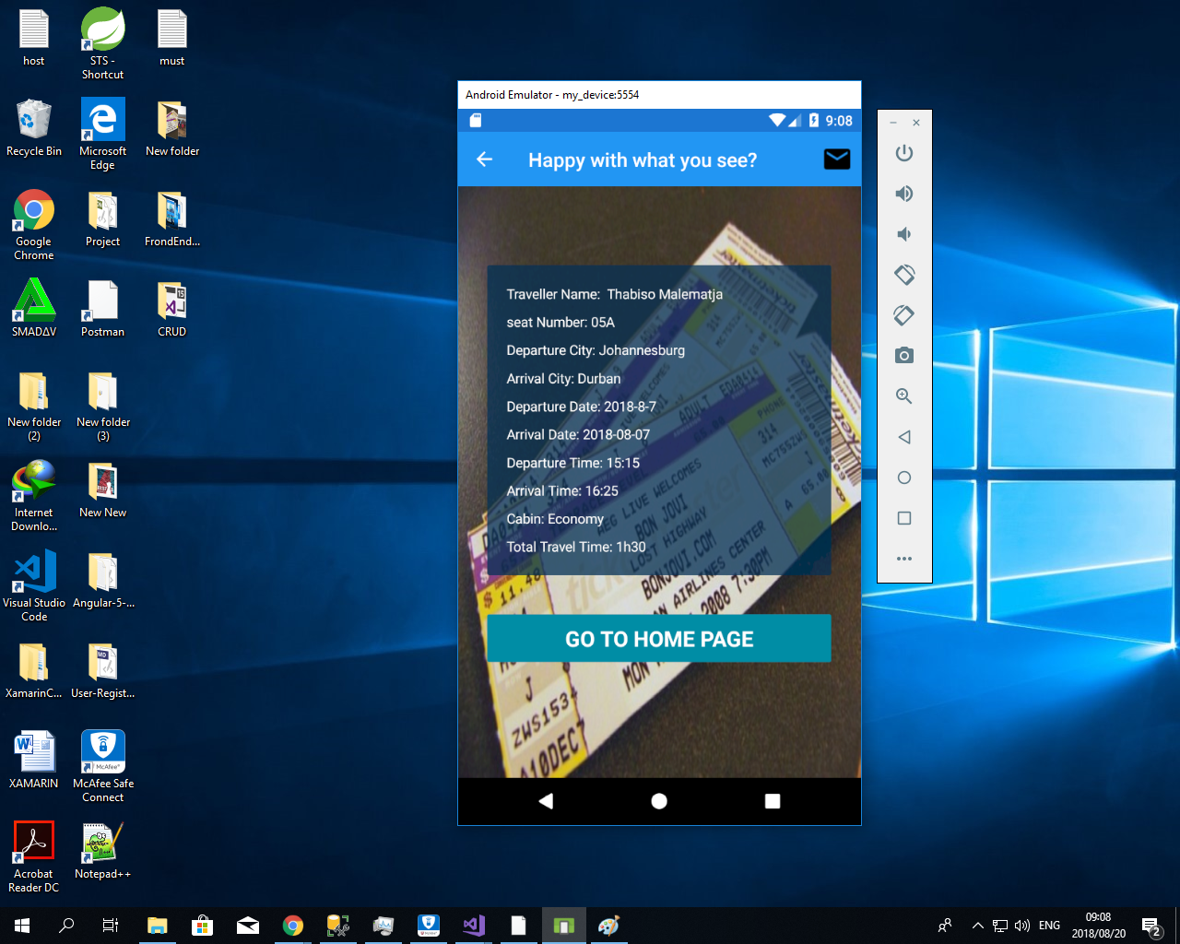
8. Ticket

